Slide 1

Image Editing and Wall Painting Color Changing App
Fahad Hakami

Slide 2


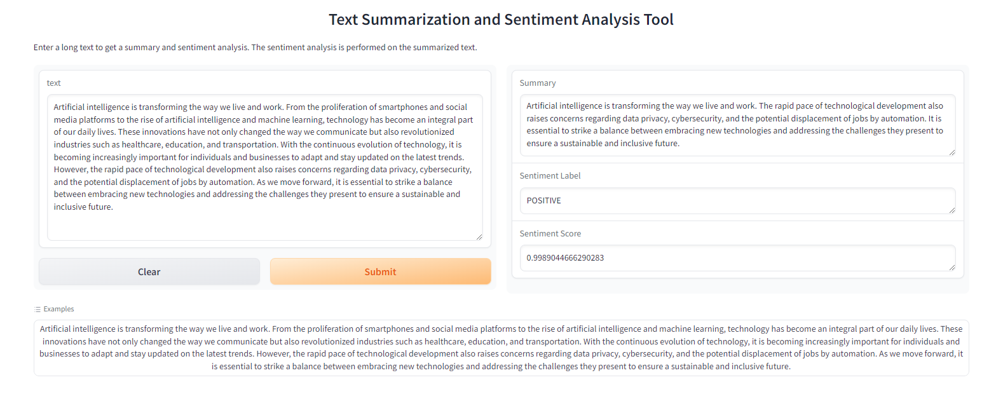
Previous Work
Project Overview:
The application uses AI to summarize texts and returns a sentiment label and score for the summarization.
The Models Used:
Summarization: facebook/bart-large-cnn
Sentiment Analysis: sentiment-analysis

Slide 3

Project Overview
General Image Editing: Modify images based on textual instructions
Paint Color Changing: Change the wall color of rooms using color names
Arabic User Interface: A fully Arabic interface for easy interaction.

Slide 4

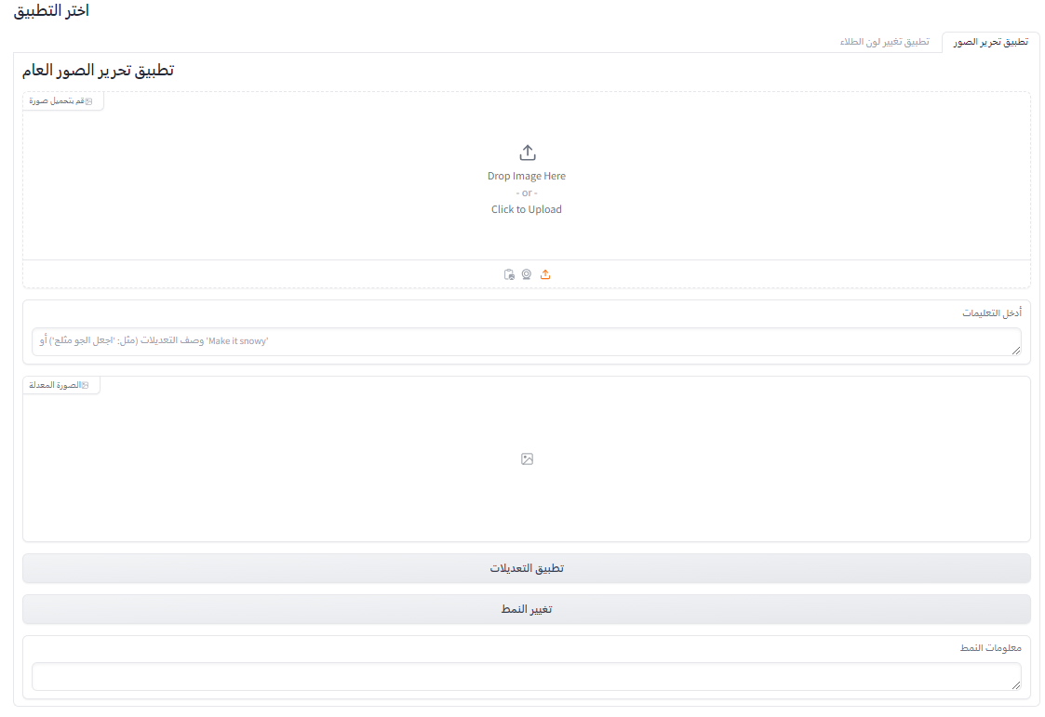
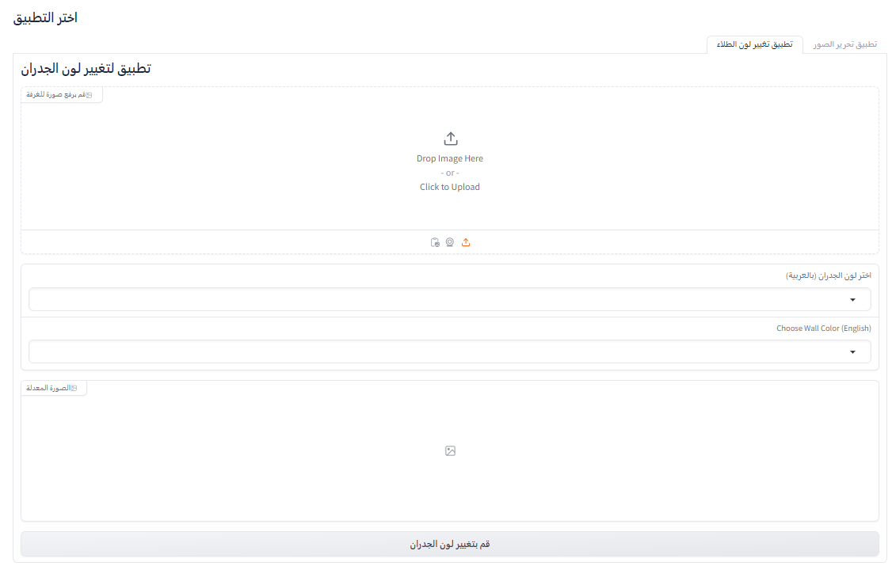
Pipeline Implementation
Step 1: Users upload an image.
Step 2: For general image editing, users provide Arabic instructions.
Step 3: For paint color changes, users select a color (in Arabic or English).
Step 4: The system translates the Arabic text and processes the image using the AI model.
Step 5: The modified image is displayed.

Slide 5


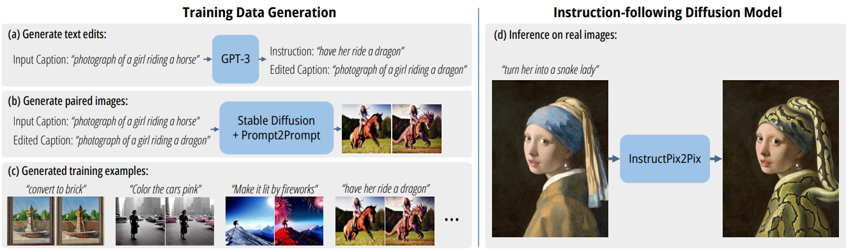
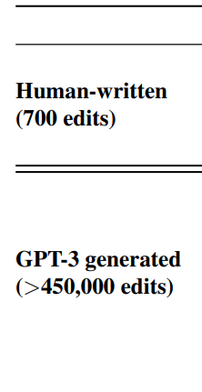
Models and Pipelines
Model 1: InstructPix2Pix
- Modify images based on natural language instructions.
- Fine-tuned for text-based image editing.
Model 2: MarianMT (Helsinki-NLP/opus-mt-ar-en)
- Translate Arabic text to English before passing it to the image editing model.
- Reliable translation from Arabic to English.

Slide 6
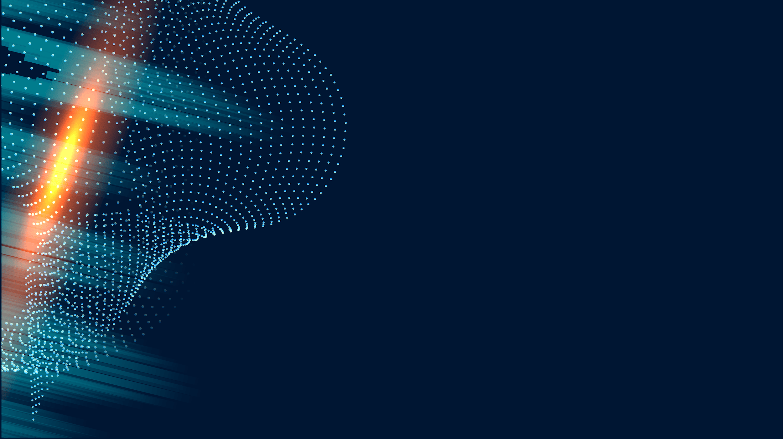
Special Measures for Arabic Language Support
Translation Pipeline: The MarianMT model ensures accurate translation of instructions for the image editing model.
Color Translation: Arabic color names are automatically translated before processing.
Full Arabic Interface: All text inputs, buttons, and labels are translated to Arabic.
RTL Layout: The interface uses right-to-left styling for better usability by Arabic-speaking users.

Slide 7
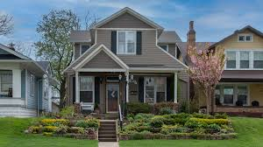
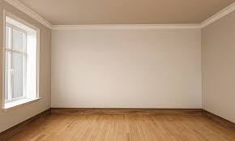
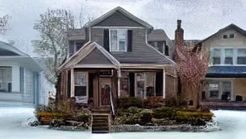
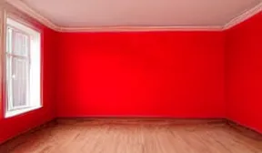
Results
General Image Editing:
Paint Color Changing :
Before Editing
Before Editing
After Editing
After Editing
Prompt: اجعل الجو مثلج
Prompt: paint the walls with red color

Slide 8
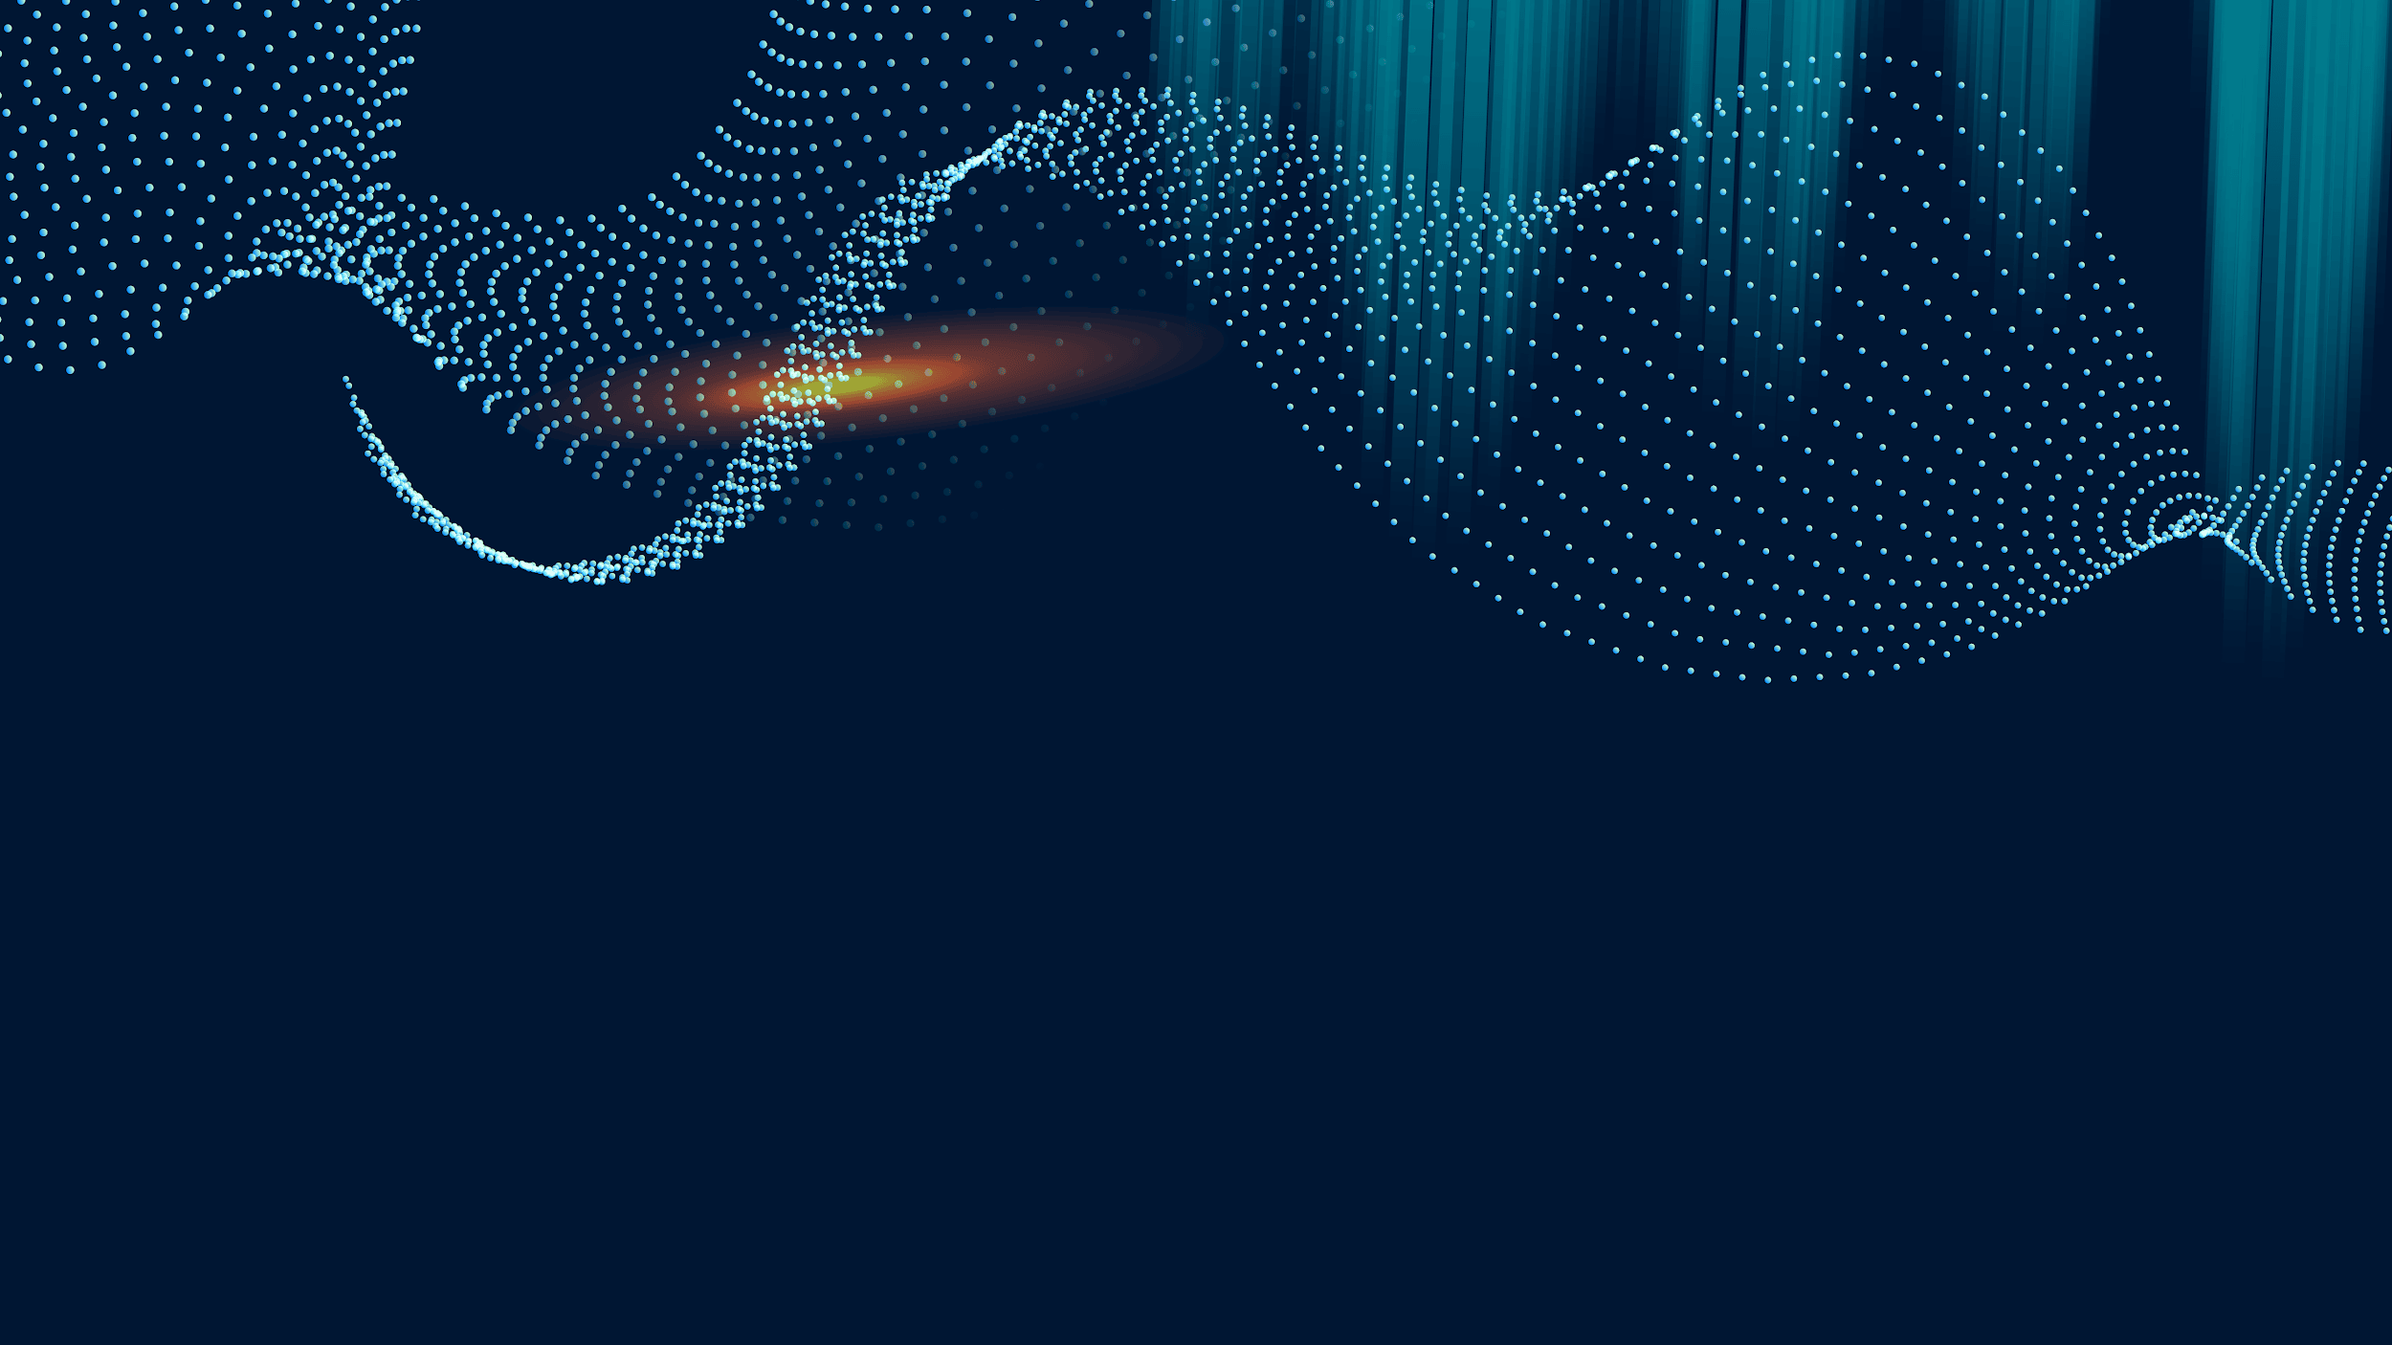
GitHub Repository and Hugging Face Space
GitHub Repository:
Link: GitHub Repo
Hugging Face Space:
Link: Hugging Face Space
InstructPix2Pix Model Paper:
Link: InstructPix2Pix Model Paper

